Slide 1

BAIL STATUS AND AMOUNT PREDICTION
DATA 606: Capstone Project
Author: Snigdha Panakanti
Term: Summer 2023
Professor: Chaojie Wang

Slide 2
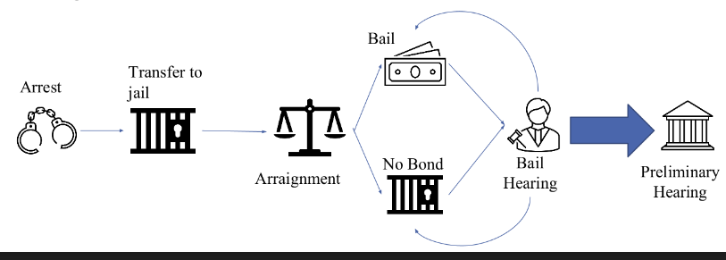
What is Bond?
Bail or bond refers to the fee or condition by which an arrested person is permitted to leave prison pending trial or hearing. (ABA)
When the charges are first presented at the arraignment, bail is determined and set.
After an arraignment, a bail hearing may be conducted to modify bail. There can be multiple bail proceedings for a defendant.

Slide 3
How is Bail determined?
Bail is determined using the following factors:
Risk of defendant returning to court
Danger to community
Type of Alleged Crime
Likelihood of defendant fleeing
Bail Amount is determined by affordability ( in some jurisdictions), along with deterrent factor.
NMR conditions are determined using facts of case and granted in cases where they are likely to be followed.

Slide 4
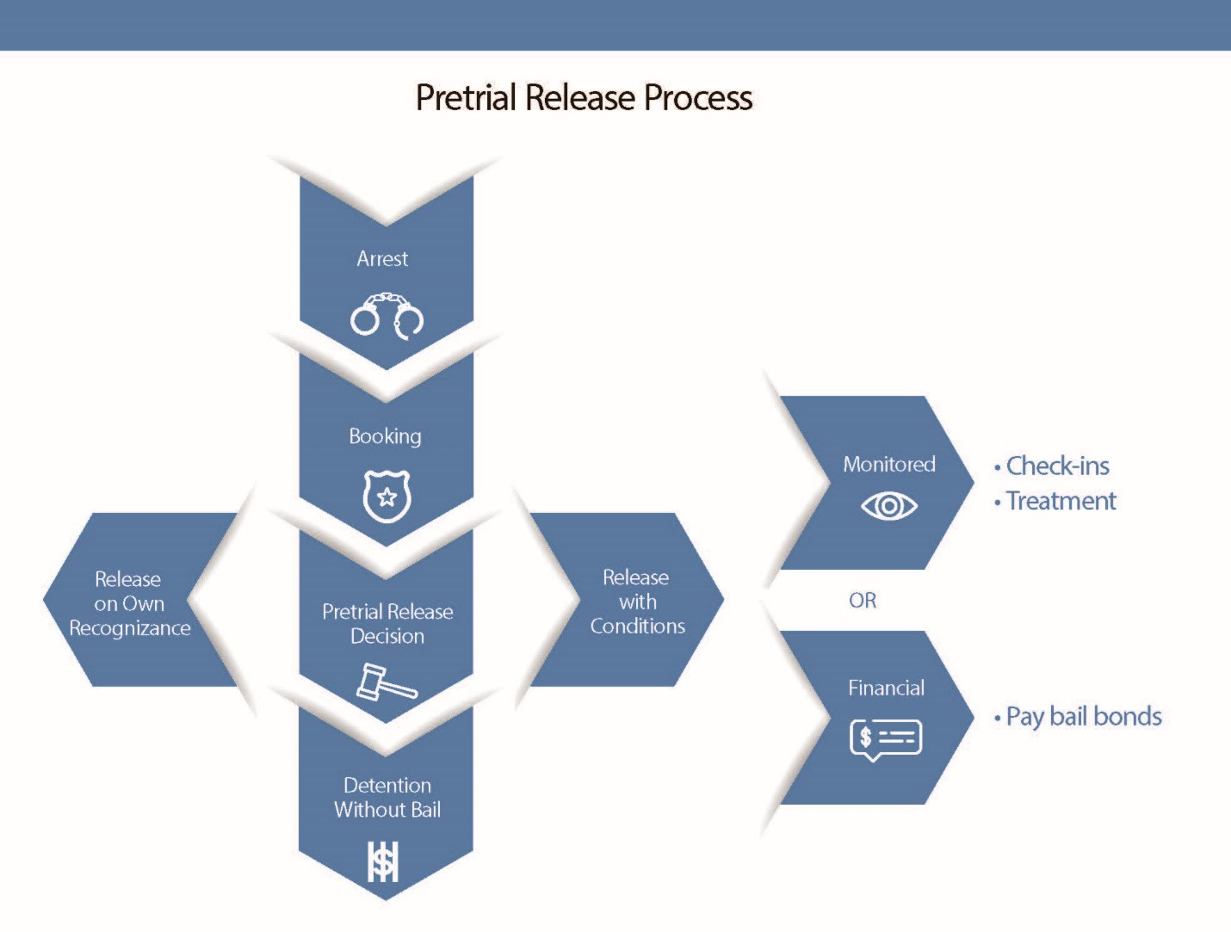
Release Decisions
Remanded/ Held Without Bond
Released on Bond
Released on Non-monetary
conditions
Released on Recognizance

Slide 5

Research questions
Can we predict whether bail will be set?
Can we predict the bail amount?

Slide 6
Dataset
NYC Pretrial Release data
Source: NY Courts. Gov
https://ww2.nycourts.gov/pretrial-release-data-33136
Shape: (283034, 108)
Date Range: 1/1/2018 – 6/30/2021
Fields: Race, Gender, Age, Release Decision, Bond Amount, prior
offenses

Slide 7
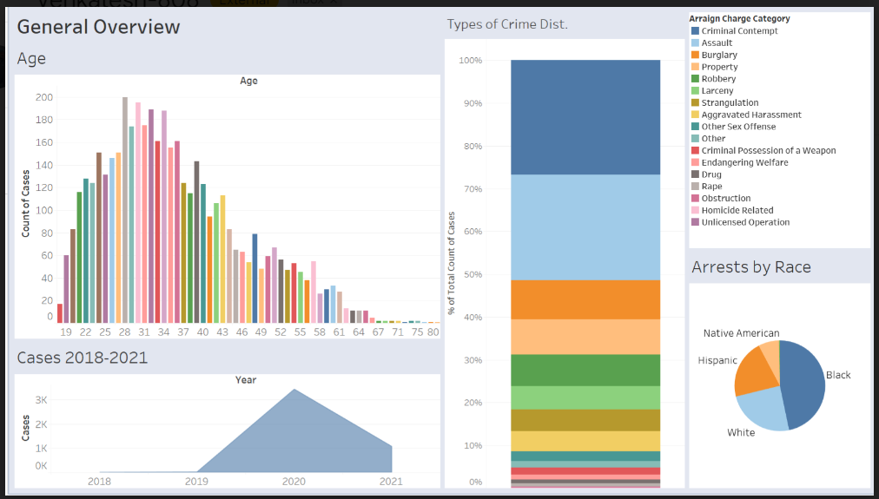

Slide 8
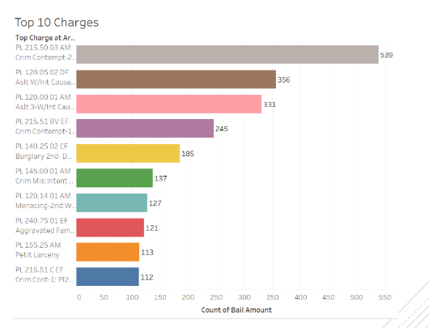
Top 10 Charges

Slide 9
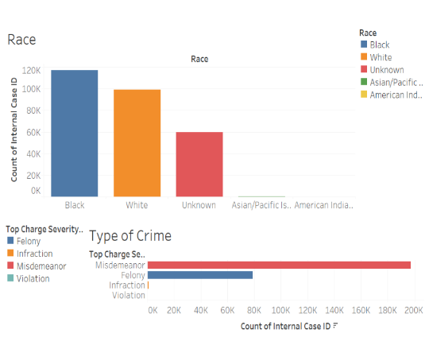
Demographics

Slide 10

Bail Status Prediction

Slide 11
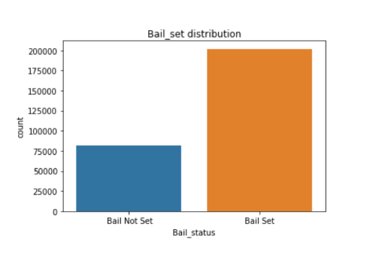
Bail Set Distribution

Slide 12
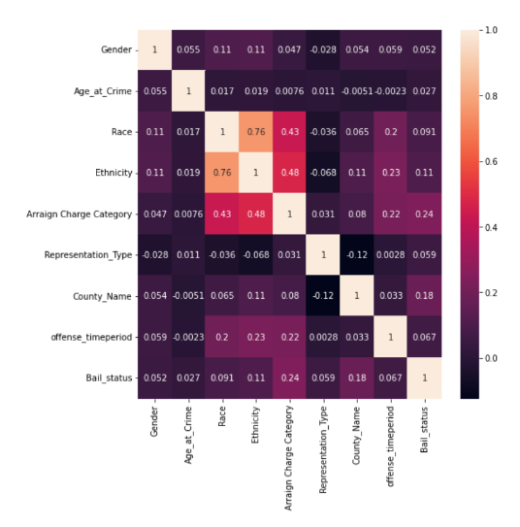
Heatmap

Slide 13
Baseline Model
Normalize the dataset to have same scaling.
Split the tidy data as test and train 30% and 70% respectively.
Fed the baseline model with the test and train dataset to have base accuracy score.
Accuracy Score from Baseline Model: 71.18%

Slide 14

Logistic Regression
Accuracy: 0.7248706426216429
F1 Score: 0.8303783916726344
Precision: 0.7393757487536874
Recall: 0.9469264526347049

Slide 15

Gaussian Naive Bayes Model
Accuracy: 0.7103333372443652
F1 Score: 0.8216339623732046
Precision: 0.730892825008355
Recall: 0.9381001088857359

Slide 16

k-Nearest Neighbors Classifier Model
Accuracy: 0.7668633915685975
F1 Score: 0.8457274181276107
Precision: 0.7987797723806171
Recall: 0.8985382914838156

Slide 17
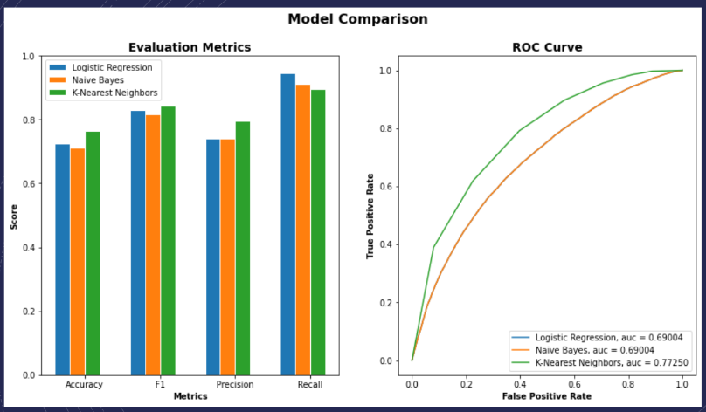

Slide 18
Modelling after parameter tuning
K-NN algorithm | Accuracy | Precision | F1 Score
K Value - 7 | 76.68% | 79.87% | 84.57%
K Value - 5 | 77.36% | 80.90% | 84.86%
Modified Test and train size | 82.84% | 86.35% | 88.19%

Slide 19

Bail Amount Prediction

Slide 20
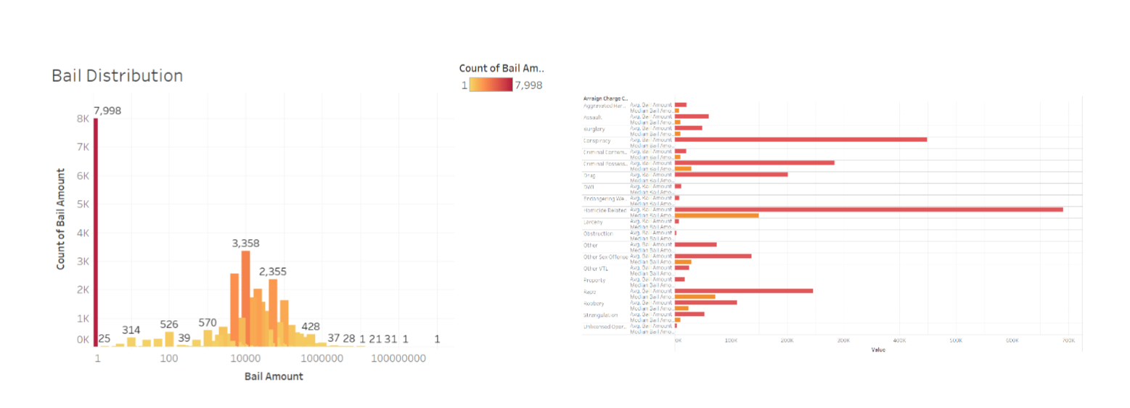
Bail Amount Distribution

Slide 21
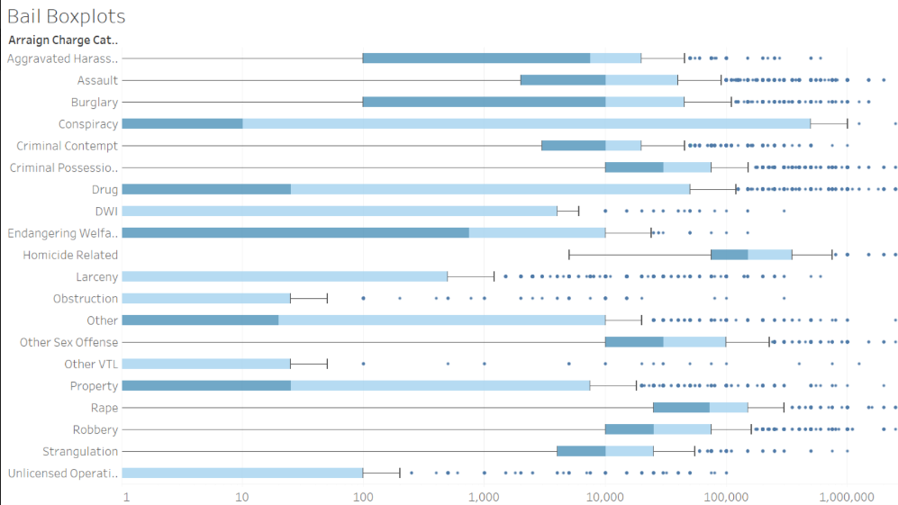

Slide 22
Linear Regression Models
Model 1:
Features: Crime, Race, Gender, Prior offenses, Age, Pretrials attended, Court ORI
R2: -1.9998669021771142e+17
MSE: 1.6405684251539064e+16
Model 2:
Features: Crime, Race, Gender, Court ORI
R2: -1.7616017530740327e+21
MSE: 1.4450878982791651e+20

Slide 23
Decision Tree Regressor
Model 1:
Features: Crime, Race, Gender, Prior offenses, Age, Pretrials attended, Court ORI
R2: 0.16243216969372332
MSE: 0.06870893932137538
Model 2:
Features: Crime, Race, Gender, Court ORI
R2: 0.45766466598630506
MSE: 0.04448918301907723

Slide 24
K Neighbors Regression
Model 1:
Features: Crime, Race, Gender, Prior offenses, Age, Pretrials attended, Court ORI
R2: 0.4452545916651911
MSE: 0.04550791854810132
Model 2:
Features: Crime, Race, Gender, Court ORI
R2: 0.4441528959048866
MSE: 0.045597588786437285

Slide 25
SVR
Model 1:
Features: Crime, Race, Gender, Prior offenses, Age, Pretrials attended, Court ORI
R2: 0.5377796617844597
MSE: 0.03791772800054157
Model 2:
Features: Crime, Race, Gender, Court ORI
R2: 0.5247095330454447
MSE: 0.038989317577876895

Slide 26

We can model whether people receive Bail using classification models.
We cannot reliably model bail amounts without more information. Bail amounts range from $1 to $1 Billion.
The next steps of this project would be to create an interface that people could interact with to predict bail.

Slide 27

Questions
Comments
Concerns

Slide 28
References:
How Courts Work. (2019, September 9). How Courts Work. https://www.americanbar.org/groups/public_education/resources/law_related_education_network/how_courts_work/bail/
Bail Information for Consumers. (n.d.). Bail Information for Consumers | Department of Financial Services. https://www.dfs.ny.gov/consumers/bail#:~:text=New%20York%20laws%20limit%20how,and%20the%20defendant%20is%20released.

